Slide 1
Employee Payroll System
Course Instructor: Presented by:
N.AKHILA, M.Tech (Ph.D),
ASSISTANT PROFESSOR,
AIML DEPTARTMENT
25B11AIB60 | SAILA HARSHITH
25B11AI230 | CHITTURI DEVI SRI PRASAD
25B11AI963 | PITHANI BHARATH MAHESH
26B21AI045 | INNAMURI KARTHIK

Slide 2
Contents
Abstract
Problem Statement & Objectives
Planned Modules / Functions
Users of the system
Algorithm
Flowchart
Modules/Functionalities
Future Enhancements
Architecture Diagram
ER Diagram / DFD
Planning and Timeline Diagram
Role of each individual

Slide 3
Abstract
The Employee Payroll System is a software application designed to automate and simplify the process of managing employee salaries and payroll information. The system maintains employee details such as employee ID, name, department, designation, basic salary, allowances, deductions, and net salary. It calculates salaries accurately by considering working days, overtime, bonuses, taxes, and other deductions. The system reduces manual calculations, minimizes errors, saves time, and provides easy access to payroll records. It can also generate salary slips and payroll reports for employees and management.
The employee payroll system provides an efficient, accurate, secure, and organized solution for managing an organization's payroll activities.

Slide 4
Problem Statement & Objectives
Problem Statement
Errors in attendance and salary records.
Difficulties in managing employee information.
Time-consuming preparation of salary slips .
Difficulty tracking deductions and allowances.
Objectives
Maintain employee information.
Manage attendance and leave records.
Calculate allowances and deductions.
Maintain accurate payroll records.
Reduce manual work and calculation errors.

Slide 5
Planned Modules / Functions
Employee Management Module – create, update, and delete employee records
Attendance Management Module – record employee attendance, working hours, and leave
Salary Management Module – calculate basic salary, allowances, deductions, and net salary
Payroll Processing Module – process monthly payroll and generate salary details
Salary Slip Module – generate and provide employee salary slips
Report Generation Module – generate payroll, salary, attendance, and employee reports

Slide 6
Users of the System
Admin – manages employee records, attendance, salary details, and payroll processing
Payroll Manager – calculates salaries, allowances, deductions, and generates payroll
Employees – view personal details, attendance, salary information, and salary slips
Department Manager – monitors employee attendance, leave, and department records
System Administrator – manages user accounts, system settings, and database records

Slide 7
Algorithm
• Step 1: Start the application.
• Step 2: Display the main menu.
• Step 3: Accept the user's choice.
• Step 4: Enter or retrieve employee information such as Employee ID, Name,
Department, and Basic Salary.
• Step 5: Enter salary components such as allowances, bonuses, and deductions.
• Step 6: Calculate the Gross Salary.
• Step 7: Calculate the Net salary.
• Step 8: Store or update the employee payroll details in the database.
• Step 9: Display the employee salary details and payroll report.
• Step 10: Exit the application.

Slide 8
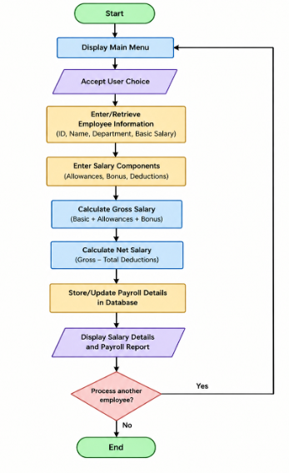
Flowchart

Slide 9
Modules / Functionalities
Employee Class – stores employee ID, name, department, designation, contact
details, and joining date
Attendance Class – records employee attendance, working hours, overtime, and
leave details
Salary Class – stores basic salary, allowances, deductions, and calculates net salary
Payroll Class – processes monthly payroll and maintains salary payment records
Leave Class – manages employee leave requests, leave types, and approval status
Salary Slip Class – generates salary slips containing employee and salary details
Report Class – generates payroll, attendance, salary, and employee reports
Admin Class – manages employee records, payroll data, users, and system
operations

Slide 10
Future Enhancements
  • Database Integration – Store employee and payroll records in a database for
  secure and efficient data management.
  • User Login & Authentication – Provide separate login access for HR
  managers, administrators, and employees.
  • Employee Self-Service – Allow employees to view their salary details, payslips, attendance, and deductions.
  • Automated Salary Calculation – Automatically calculate gross salary, deductions, taxes, bonuses, and net salary.
  • Payslip Generation – Generate and download digital payslips for employees.
  • Attendance & Leave Management – Integrate attendance and leave records with payroll calculations.

Slide 11
Conclusion
The Employee Payroll System is designed to simplify and automate the process of managing employee salaries and payroll records. It reduces manual calculations, minimizes errors, and provides quick access to employee salary information.
Key benefits:
Automates salary and deduction calculations.
Maintains employee payroll records efficiently.
Reduces paperwork and manual errors.
Generates clear payroll reports and payslips.
Provides a structured and user-friendly payroll management system.
Overall, the system helps organizations manage payroll in a faster, accurate, and organized manner.

Slide 12
Role of Each Individual
Roll No. | Name | Role / Responsibility
25B11AIB60 | Saila Harshith | Class design, Employee & Payroll modules
25B11AI230 | Chitturi Devi Sri Prasad | Coding – core modules & file handling
25B11AI963 | Pithani Bharath Mahesh | Testing, debugging & salary calculation
26B21AI045 | Innamuri Karthik | UI design, documentation & presentation

Slide 13


